Slide 2
Digital Technology
TK1104
Guest lecturer: Peyman Teymoori
peymant@ifi.uio.no
Lecturer: Toktam Ramezanifarkhani
Toktam.Ramezanifarkhani@kristiania.no
Toktamr@ifi.uio.no

Slide 3
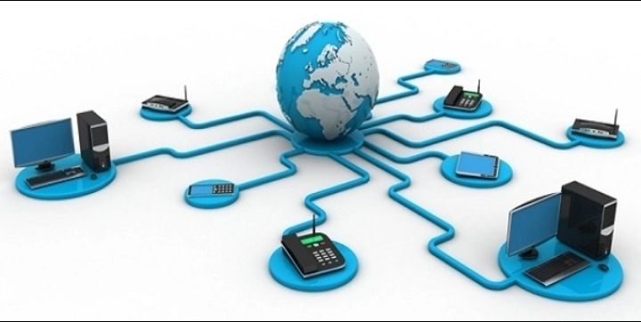
Computer Networks – Transport Layer

Slide 4
Learning objectives
To learn the transport layer services:
TCP, UDP
To learn about multiplexing/demultiplexing

Slide 5
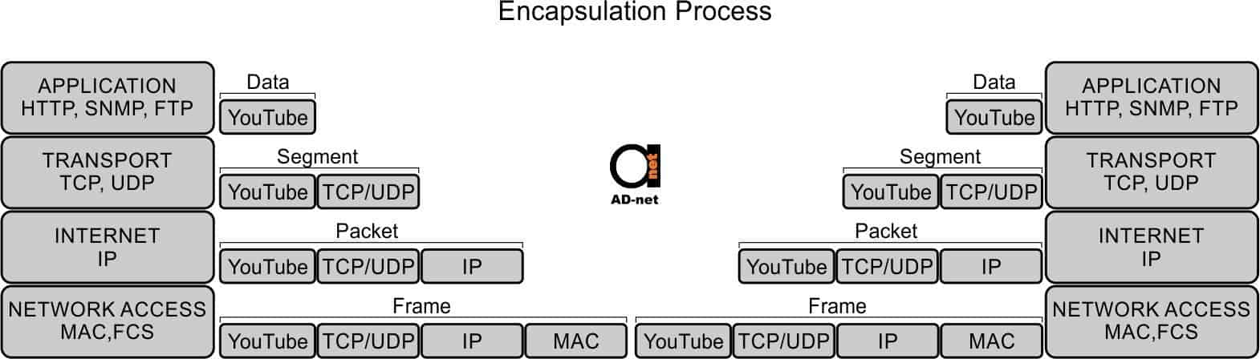
Recap: Packet Encapsulation

Slide 6
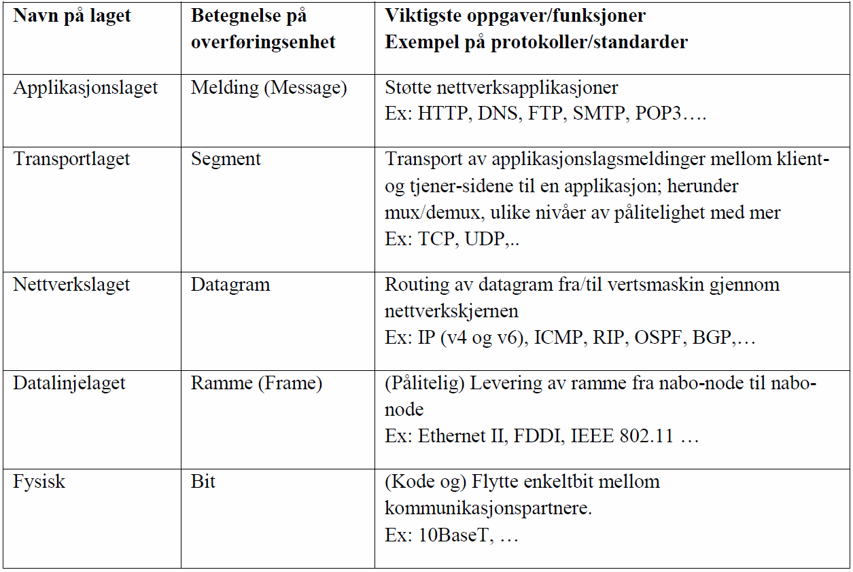
Transport layer
Layer´s name
designation of transmission unit
Most important tasks / functions
Example of protocols / standards
Application layer
Message
Support network applications
Ex: HTTP, DNS, FTP, SMTP, POP3
Transport layer
transport of application layer messages between client and server pages of an application: including mux / demux, different levels of reliability and more ..
Ex: TCP, UDP ...
The network layer
routing of datagram from / to host through the network core
Ex: IP (v4 and v6) ICMP, RIP, OSPF, BGP
The data line layer
Frame
(Reliable) delivery of frame from neighbor node to neighbor node.
Ex: Ethernet II, FDDI, IEEE 802.11
Physical
(Code and) Move single bit between communication partners.
Ex: 10BaseT,

Slide 7
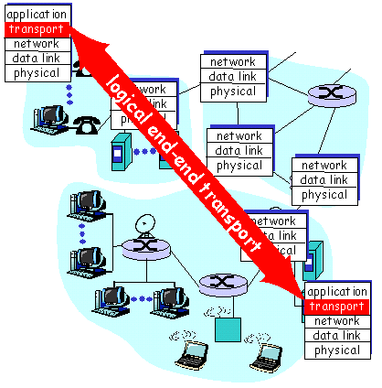
Transport service
Sets up logical communication between application processes on different clients
The transport protocol is run in each end system
Data transfer between processes

Slide 8
Transport-Layer Protocols
The internet uses the network-protocol IP
does its best, but gives no guarantees
«Best effort»
UDP
Sends a datagram, which may consist of several parts, to the recipient and hopes it arrives
Improves IP only with end-to-end control and error-checking
TCP
Creates a "fixed" connection.
Adds move-control, sequence-number, time control, error checking and traffic-cork control (congestion control)

Slide 9
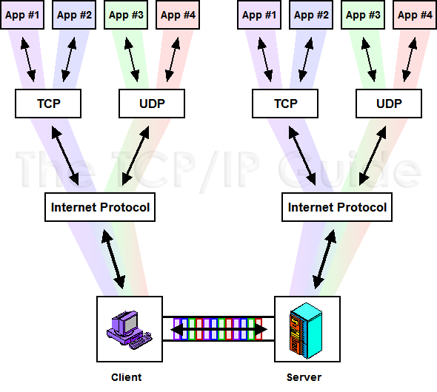
Multiplexing/ demultiplexing

Slide 10
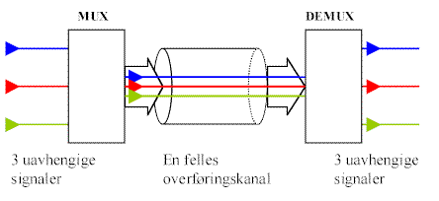
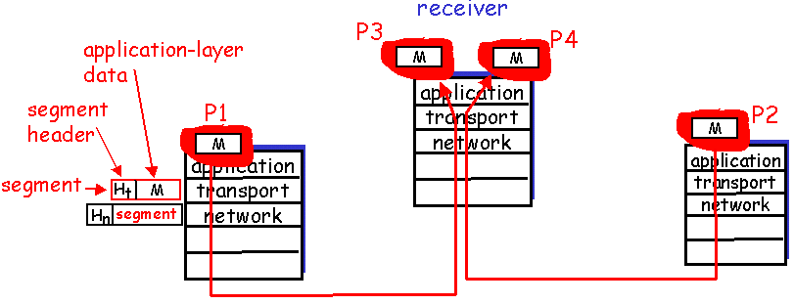
Multiplexing/ demultiplexing
Segment
Data unit exchanged between the transport layers
TPDU (Transport Protocol Data Unit).
Demultiplexing
Deliver received segments to the correct process

Slide 11
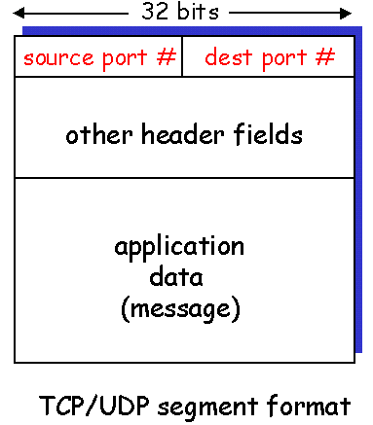
Multiplexing <port number
Collects data from application processes and packs them with a header.
The header contains the port number of the sender and receiver.
Port number = 16 bit unsigned integer
The ports 0-1023 are «well known» (RFC 1700)
Secure Shell: port 22
SMTP: port 25
DNS: port 53
HTTP: port 80
HTTP over TLS/SSL: port 443
Other ports are divided into:
Registered:
1024-49151 (0x0400-0xBFFF)
Can be used for other purposes as well, but is registered for a service with IANA.
Private / Dynamic:
49152-65535 (0xC000-0xFFFF)

Slide 12
Transport layer 1
The first main task that is solved on the transport layer is thus to multiplex / demultiplex from / to local processes and the common channel (Internet)!
Port number acts as ID number for local and contacted process!

Slide 13
User Datagram Protocol

Slide 14
UDP (User Datagram Protocol)
Very simple Internet transport layer protocol
Segments may be lost
Segments can be delivered in the wrong order
Do not handshake between sender and receiver.
Why UDP?
No connection established no delay
Does not set up a common state for sender and receiver
Small segment head
No traffic jam control.
Enables broadcasting
Should you need reliability,
you can add it to the program at the application layer level
put the pedal to the metal

Slide 15
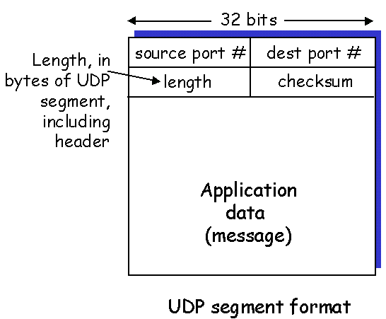
UDP
Often used in connection with multimedia where the human brain can correct the errors
Other uses
DNS
SNMP
The receiver's application can provide error handling

Slide 16


Slide 17
See the «theory» behind TCP / IP at the end of the slide deck for those who are interested Here we will focus on how TCP works in practice
Transmission Control Protocol

Slide 18
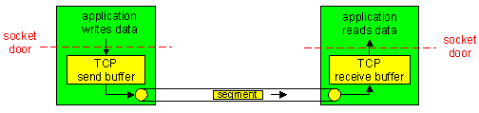
TCP (Transmission Control Protocol)
Point to point
One sender, one receiver
Reliable, arranged byte-stream
Pipeline
Flow and congestion control determines window size.
Sender and receiver buffer
Full duplex data
Both can send and receive at the same time.
Connection-oriented
Handshake before data transfer
Flow control
The sender does not drown the recipient

Slide 19
TCP header structure
FLAG:
32 bit
URG: urgent data
indicates byte
(octets),
not segments
sender port #
Receiver port #
sequence number
ACK: ACK #
valid
Ackowledgement number
number of bytes
receiver
can receive
("window")
head
len
not
used
U
Receiver window
A
P
R
S
PSH: send data immediately
F
checksum
Urg data points
RST, SYN, FIN:
establishment of and
disconnection of
connection
Options (variable length)
If U-flag:
Indicates where in the segment
urgent data is located
application
data
(variable length)
Checksum
(as in UDP)
Extra opportunities:
SACK? WS? MSS / MTU?

Slide 20
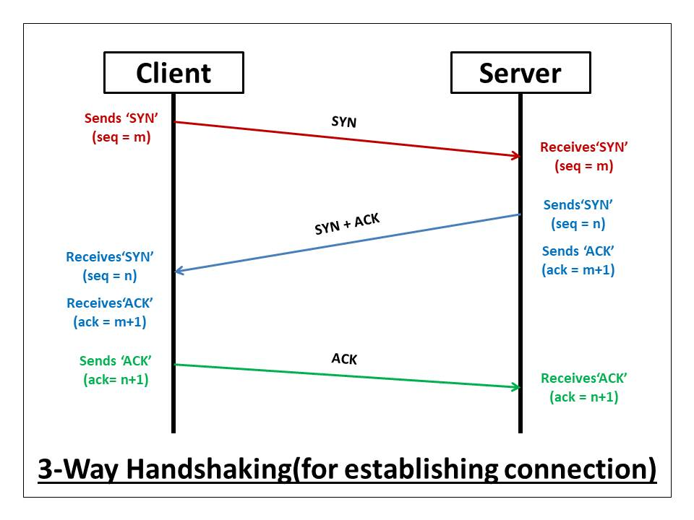
TCP: Connection startup
Transmitter and receiver establish a connection before data segments are exchanged.
Initializes TCP variables
Sequence number, buffers, windows .....
Client sends a special TCP segment with SYN
The SYN flag in the header set
Specifies the start sequence number
Server responds with SYN+ACK
SYN and the ACK flags in the header set
Sets up start sequence number, buffers, windows etc.
Client responds with ACK

Slide 21

Pandemic-related News!

Slide 22
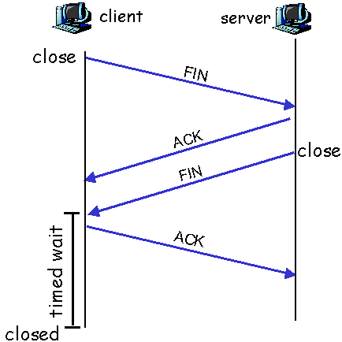
Finishing the connection
Client app closes the socket.
Client-OS sends TCP FIN to server
Server-OS receives FIN, sends ACK
Server-app closes socket.
Server-OS sends FIN to client
Client-OS receives FIN, sends ACK
Server-OS receives ACK
The connection ended.
NB! Other methods are also used !!
For example, the RESET flag (from Server)
Three Way: FIN, FIN + ACK, ACK

Slide 23
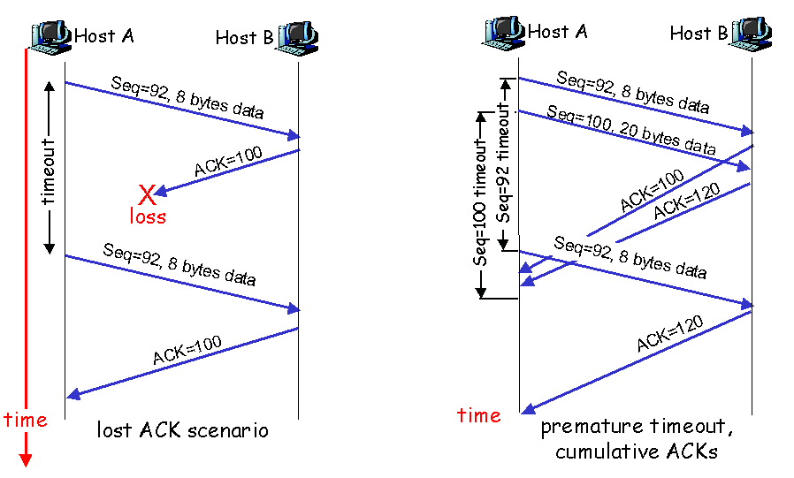
Resending
Host A
Host B
Seq=92, 8 bytes data
Seq=100, 20 bytes data
Seq=92 timeout
ACK=100
Seq=100 timeout
ACK=120
Seq=92, 8 bytes data
ACK=120
premature timeout,
cumulative ACKs

Slide 24
Fast shipping
The timeout period is often relatively long
If the sender receives 3 ACK on the same data before timeout, it is interpreted as packet loss -> retransmission of the following segment
Host A
Host B
seq # x1
seq # x2
seq # x3
X
ACK x1
seq # x4
seq # x5
ACK x1
ACK x1
ACK x1
triple
duplicate
ACKs
resend seq X2
timeout
time

Slide 25
How to tell a joke in a TCP vs. UDP style!
TCP:
Hi, I'd like to hear a TCP joke.
Hello, would you like to hear a TCP joke?
Yes, I'd like to hear a TCP joke.
OK, I'll tell you a TCP joke.
Ok, I will hear a TCP joke.
Are you ready to hear a TCP joke?
Yes, I am ready to hear a TCP joke.
Ok, I am about to send the TCP joke. It will last 10 seconds, it has two characters, it does not have a setting, it ends with a punchline.
Ok, I am ready to get your TCP joke that will last 10 seconds, has two characters, does not have an explicit setting, and ends with a punchline.
I'm sorry, your connection has timed out....
Hello, would you like to hear a TCP joke?
UDP:
Wanna hear a TCP joke?
Yes!
Was it good?
What?!

Slide 26
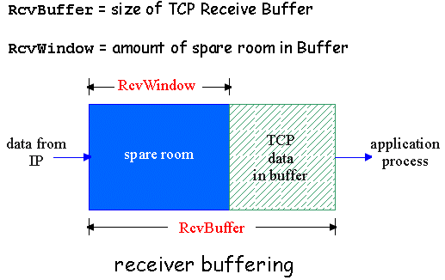
Flow Control = Window
The sender should not "drown" the recipient by sending too much, too fast.
Receiver informs sender about free buffer capacity.
RcvWindow in TCP segment
The sender takes this into consideration

Slide 27
Traffic jam / Congestion
Too many sources send too much data too fast for the network (routers) to handle.
This is different from flow control which depends on the capacity of the end systems and is controlled by the exchange of window sizes (RWIN).
Results in..
lost packets (overflowing router buffer)
long delays (queue in router buffer)
This can be, and often is, a big problem!

Slide 28
Congestion Control Principles
End-to-end control
No feedback from the network
Endpoint even finds out if there are problems
Symptoms: Delay, packet loss
TCP uses this principle.
Network-assisted control
The routers provide feedback to the ends
Puts bit flag in packet header (SNA, ATM ......)
Direct feedback (choke packet)

Slide 29
TCP fairness
Objective: if K TCP sessions share the same bottleneck link with data rate R, each of them should have an average data rate of R / K
TCP connection 1
bottleneck -
router,
capacity R
TCP
connection 2

Slide 30
TCP Fairness
Fairness and UDP
Multimedia applications "rarely" use TCP
does not want data rate limited due to traffic jam control.
Instead uses UDP:
pumps audio / video at a constant rate, tolerates packet loss
Fairness and parallel TCP connections
nothing prevents the appl from opening parallel connections between two machines.
Browsers often do this
Example: link with rate R with 9 connections:
new appl asks for one TCP connection, gets rate R / 10
new appl asks for 11 TCP connections, gets rate R / 2!

Slide 31
End

Slide 32
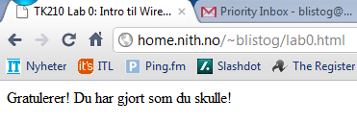
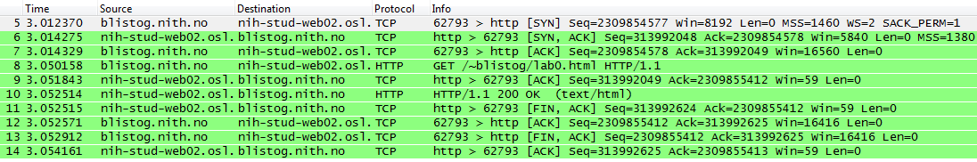
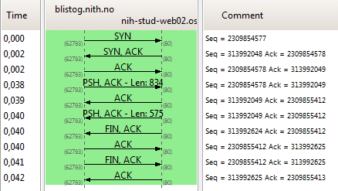
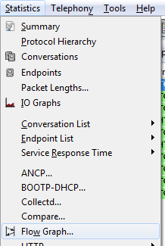
Wireshark: Easy transfer
1) Experiment
2) Result
3) Flow Graph
Connection
Data transfer GET + ACK + 200OK
Disconnection

Slide 33
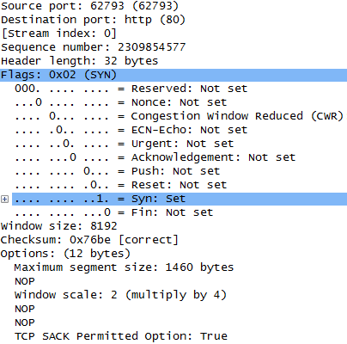
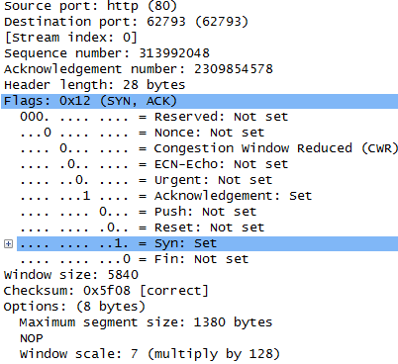
Wireshark: SYN and SYN + ACK
Client
Server
SYN
SYN + ACK
Exchanges sequence number
Agreements MSS
Agreements / exchanges Window scaling

Slide 34
Exercises
Text assignment set
You MUST have completed practical exercises to 0x05 and 0x06!
When we talk briefly about tools such as ping, netstat, etc., then you MUST test them in the practice lessons use text-based shell and test all tools we have been to, even if it is not specifically mentioned in the exercise text…
Practical exercises
Install ncat
Is part of NMAP; https://nmap.org/download.html
Run online port scan against own machine
https://www.grc.com/default.htm
Scroll down and click on the ShieldsUp!
Click Proceed, and then click Common Ports
(Should not give any findings, and this is not the Information Security subject,
the purpose is to learn about port numbers…)
Wireshark now look at the transport layer
Wireshark go through the latest tasks with HTTP, FTP etc; but look at the transport layer

Slide 35
For optional self-study
For those who want to learn some topics in more depth to better understand, here are some extra topics related to today's teaching, it must be expected some personal work to understand these topics.
There will be no questions on the exam from these, and this is therefore not considered to be part of the syllabus.

Slide 36
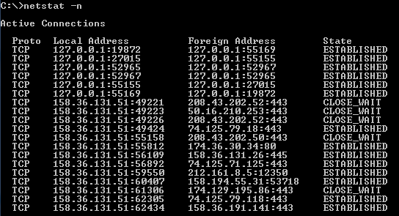
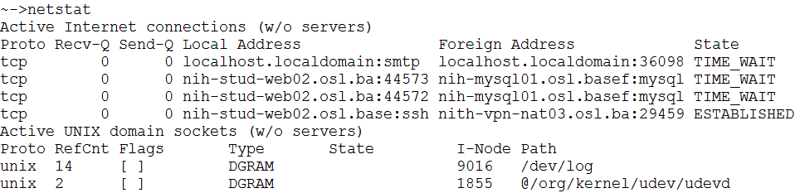
netstat
netstat is the command that provides an overview of open ports:
netstat –a : UDP
netstat –s : statistics
netstat –r :routing table
netstat –n : not DNS-name
+ many more to see which process o.l. (–B on Win7 etc)
Klient IP-adresse: portnummer
Server IP-adresse: portnummer
Forbindelsens Tilstand
Windows
OSX

Slide 37
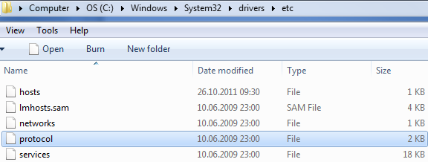
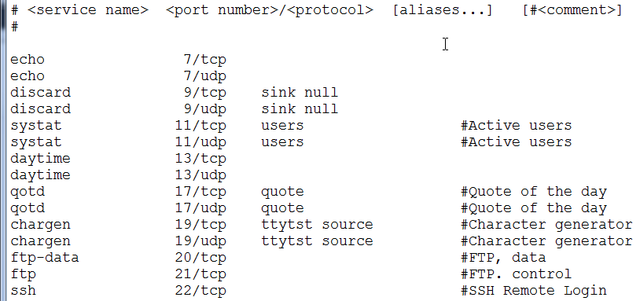
Overview: Services list
Both in Windows (see above) and in OSX (/ etc) there is a list (services) with which ports are registered with which protocols / services
This one decides what is stated as the protocol name of the netstat

Slide 38
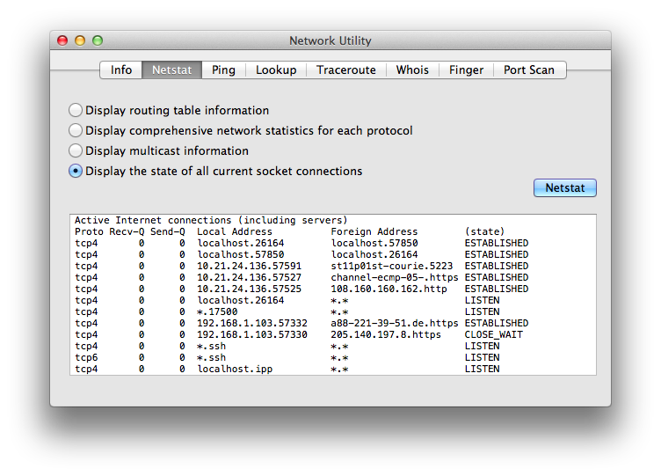
OSX: Network Utility
OSX (under Applications / Utilities) has a GUI against the standard tools

Slide 39
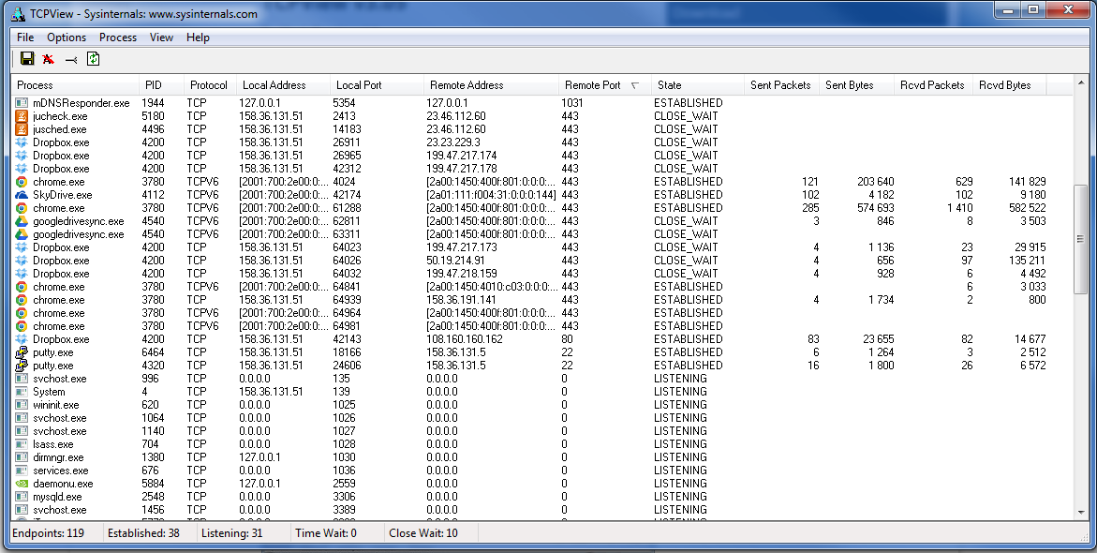
Win: TCPView
From MS you can download TCPView
GUI that shows "most" things you can find with netstat

Slide 40
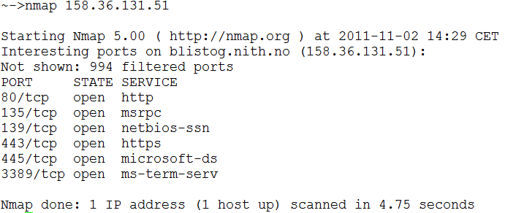
Gates and security (firewalls)
Access to a running application is via a port number (cf. experiences with HTTP in exercises)
Port numbers can thus tell us quite a bit about which programs are running on a machine
Common port scanning tools are: nmap
Port scanning will be able to tell you (a lot) about the OS and what services it is running
Most software firewalls are there to filter out such "unwanted" requests.

Slide 41
UDP checksum
Sender
Perceives the segment as composed of 16 bits words
Summarizes all of the words
Takes 1’s complement of the sum (flips)
Puts checksum into the header of the segment.
Receiver
Summarizes all 16-bit words in the received segment, including the check sum.
If sum= 1111 1111 1111 1111 => everything OK
At best, this only gives an indication of whether an error has occurred during the transfer

Slide 42
Ex: Internet checksum
Note: Mean in the most significant position is added to the LSb (Least Significant Bit)!
Ex: Two 16 bit parts of the total package are added together
1 1 1 1 0 0 1 1 0 0 1 1 0 0 1 1 0
1 1 1 0 1 0 1 0 1 0 1 0 1 0 1 0 1
1 1 0 1 1 1 0 1 1 1 0 1 1 1 0 1 1
1 1 0 1 1 1 0 1 1 1 0 1 1 1 1 0 0
1 0 1 0 0 0 1 0 0 0 1 0 0 0 0 1 1
wraparound
sum
checksum

Slide 43
Transmission Control Protocol
How to achieve reliable transmission through an unreliable channel?
Principles behind...

Slide 44
Why is TCP fair?
Two competing sessions :
Additive increase gives a slope of 1, which increases gradually
multiplicative reduction reduces flow proportionally
R
evenly distributed data rate
loss: reduces window by factor 2
Forbindelse 2 gjennomstrømning
congestion avoidance: additive increase
loss: reduces window by factor 2
congestion avoidance: additive increase
R
Compound 1 flow-through

Slide 45
TCP: Versions
The biggest difference between different varieties is exactly how they handle saturation
Tahoe ("vanilla"), Reno, New Reno, Vegas, BIC / CUBIC (Linux 2.6->), CTCP (Windows Vista / 7 ->, ..)
Everyone tries to get the bit rate back up faster after packet loss
Without outperforming "vanilla" TCP
New versions should be Tahoe-friendly!

Slide 46
TCP: Nagle's algorithm
TCP + IPv4 adds 20 bytes of headers each
If we only have to transfer one letter, this means a large "overhead".
Only 1/41 = 2.4% of the package is data
With ACK from server: only 1.2% of the bandwidth is used for something useful (even less if we include the link layer header.
Nagle's algorithm
Stores data going to the same server until ACK on the previous packet is received, or the amount of data becomes> = 1 MSS (maximum segment size)
Problematic in real-time applications (eg online games) due to "delayed ACK" from the server side
Can / must be solved in the programming of the application

Slide 47
Reliable transmission
UDP sikrer mux/demux
UDP gjør det bare mulig for mottager å oppdage at bit-feil i en pakke kan ha oppstått
In the event of an error, it is common for the OS to drop the package
No error handling etc.
TCP must provide a reliable connection.
hen we need to take into account the various sources of error (noise / bit error, loss,…) and how to deal with them

Slide 48
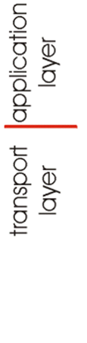
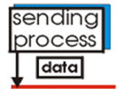
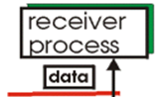
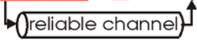
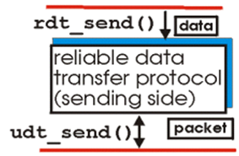
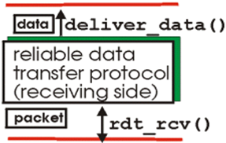
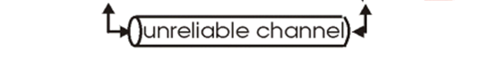
Reliability is dealing with errors
The service we want
New Software team offering the service:
=
+
If the channel is reliable, we only need mux / demux
What we want is to offer the service reliable transmission over an unreliable channel
Then you will want to create a protocol and software (methods) that will take care of this.
Cost: Greater complexity

Slide 49
Problem & Solution
Problem:
Want reliable data transfer over networks made up of unreliable media.
Solution strategy:
Starts with the ideal state (media perfect)
Introduces the problems associated with real media (noise and loss) one by one
Step by step constructs a protocol that handles the issues.

Slide 50
Different steps of reliability
We are now creating a "play protocol", which we call RDT (Reliable Data Transport).
We will look at different levels of RDT and build these up gradually
Discusses only data transport in one direction
Same as full duplex, but easier to explain
Control information goes in both directions
Uses FSM (Finite State Machines) to specify the behavior of the sender and recipient
state: when in this "state" the next state is unambiguously determined by the next event
Event that causes state transition
Actions performed during the state transition
Condi-
Tion
1
Condi-
Tion
2
event
action

Slide 51
FSM: "Practical" Example
Alarm clock rings && weekday
Turns off the clock and gets up
Sleeping
Awake
Alarm clock rings && weekend
Press “Snooze”

Slide 52
V. 1.0: Reliable transmission / channel
The chanel completely reliable
No bit errors, no loss of packages
Separate FSM for sender and receiver
Check not required
Wait for call from above
rdt_send(data)
Wait for call from below
rdt_rcv(packet)
extract (packet,data)
deliver_data(data)
packet = make_pkt(data)
udt_send(packet)
sender
receiver

Slide 53
v. 2.0: Channel with bit error
A) Detect any errors:
Send checksum together with the data package.
Errors can be detected by the recipient, but are not corrected
B) Give feedback:
Recipient sends notification of error to sender
ACK (acknowledge) sent when the package is OK.
NAK (negative ACK) sent when the package is faulty.
The sender sends the package again at NAK.
Three new mechanisms:
Error detection
Control message (receipt) from recipient to sender
Omatt transmission in case of error message

Slide 54
RDT 2.0: FSM model
rdt_send(data)
snkpkt = make_pkt(data, checksum)
udt_send(sndpkt)
receiver
rdt_rcv(rcvpkt) &&
isNAK(rcvpkt)
Wait for call from above
Wait for ACK or NAK
rdt_rcv(rcvpkt) &&
corrupt(rcvpkt)
udt_send(sndpkt)
udt_send(NAK)
rdt_rcv(rcvpkt) && isACK(rcvpkt)
Wait for call from below
Λ
sender
rdt_rcv(rcvpkt) &&
notcorrupt(rcvpkt)
extract(rcvpkt,data)
deliver_data(data)
udt_send(ACK)

Slide 55
RDT 2.0: FSM no transmission error
rdt_send(data)
snkpkt = make_pkt(data, checksum)
udt_send(sndpkt)
rdt_rcv(rcvpkt) &&
isNAK(rcvpkt)
Wait for call from above
Wait for ACK or NAK
rdt_rcv(rcvpkt) &&
corrupt(rcvpkt)
udt_send(sndpkt)
udt_send(NAK)
rdt_rcv(rcvpkt) && isACK(rcvpkt)
Wait for call from below
Λ
rdt_rcv(rcvpkt) &&
notcorrupt(rcvpkt)
extract(rcvpkt,data)
deliver_data(data)
udt_send(ACK)

Slide 56
v. 2.0: FSM bit error in transmission ..
rdt_send(data)
snkpkt = make_pkt(data, checksum)
udt_send(sndpkt)
rdt_rcv(rcvpkt) &&
isNAK(rcvpkt)
Wait for call from above
Wait for ACK or NAK
rdt_rcv(rcvpkt) &&
corrupt(rcvpkt)
udt_send(sndpkt)
udt_send(NAK)
rdt_rcv(rcvpkt) && isACK(rcvpkt)
Wait for call from below
Λ
rdt_rcv(rcvpkt) &&
notcorrupt(rcvpkt)
extract(rcvpkt,data)
deliver_data(data)
udt_send(ACK)

Slide 57
version 2.0: Fatal ERROR !!
The Problem occurs if the control message fails
The sender can then not know what happened to the package! (It certainly came out, but was it wrong or not?)
No purpose in re-sending a package that is OK.
Cannot re-send the package for fear of duplicate (Two identical packages will end up with incorrect data for the application)
Solution
The sender sets the sequence number on the packet.
For a stop / wait protocol, only 1 bit sequence number is needed.
This means that we have to double the number of conditions for both sender and receiver

Slide 58
Version 2.1: FSM sender
Can handle broken ACK / NAK
rdt_send(data)
sndpkt = make_pkt(0, data, checksum)
udt_send(sndpkt)
rdt_rcv(rcvpkt) &&
( corrupt(rcvpkt) ||
isNAK(rcvpkt) )
Wait for call 0 from above
Wait for ACK or NAK 0
udt_send(sndpkt)
rdt_rcv(rcvpkt)
&& notcorrupt(rcvpkt)
&& isACK(rcvpkt)
rdt_rcv(rcvpkt)
&& notcorrupt(rcvpkt)
&& isACK(rcvpkt)
Λ
Λ
Wait for ACK or NAK 1
Wait for
call 1 from above
rdt_rcv(rcvpkt) &&
( corrupt(rcvpkt) ||
isNAK(rcvpkt) )
rdt_send(data)
udt_send(sndpkt)
sndpkt = make_pkt(1, data, checksum)
udt_send(sndpkt)

Slide 59
2.1: FSM receiver
rdt_rcv(rcvpkt) && !corrupt(rcvpkt)
&& has_seq0(rcvpkt)
extract(rcvpkt,data)
deliver_data(data)
sndpkt = make_pkt(ACK, chksum)
udt_send(sndpkt)
rdt_rcv(rcvpkt) && (corrupt(rcvpkt)
rdt_rcv(rcvpkt) && (corrupt(rcvpkt)
sndpkt = make_pkt(NAK, chksum)
udt_send(sndpkt)
sndpkt = make_pkt(NAK, chksum)
udt_send(sndpkt)
Wait for
0 from below
Wait for
1 from below
rdt_rcv(rcvpkt) &&
!corrupt(rcvpkt) &&
has_seq1(rcvpkt)
rdt_rcv(rcvpkt) &&
!corrupt(rcvpkt) &&
has_seq0(rcvpkt)
sndpkt = make_pkt(NAK, chksum)
udt_send(sndpkt)
sndpkt = make_pkt(NAK, chksum)
udt_send(sndpkt)
rdt_rcv(rcvpkt) && !corrupt(rcvpkt)
&& has_seq1(rcvpkt)
extract(rcvpkt,data)
deliver_data(data)
sndpkt = make_pkt(ACK, chksum)
udt_send(sndpkt)

Slide 60
2.1: Analysis
Sender:
Adding package number (0, 1)
Must check if ACK / NAK package is corrupt
Must remember number of last sent package
This gives complexity; 2 states
Must have two different states to "remember" the package number of the "current" package
Receiver:
Must check if package is duplicate
The state indicates whether 0 or 1 is the expected sequence number
Note! The recipient cannot know if the last sent ACK / NAK has been received by the sender

Slide 61
version 2.2: NAK-free protocol
Same as 2.1, but without separate NAK messages
Instead of NAK, the receiver sends ACK for the last correctly received packet
The package number must then be with the ACK
Duplicate ACK to sender entails the same as NAK in 2.1
rdt_send(data)
sndpkt = make_pkt(0, data, checksum)
udt_send(sndpkt)
rdt_rcv(rcvpkt) &&
( corrupt(rcvpkt) ||
isACK(rcvpkt,1) )
Wait for call 0 from above
Wait for ACK
0
udt_send(sndpkt)
sender FSM
fragment
rdt_rcv(rcvpkt)
&& !corrupt(rcvpkt)
&& isACK(rcvpkt,0)
rdt_rcv(rcvpkt) &&
(corrupt(rcvpkt) ||
has_seq1(rcvpkt))
ACK0
Λ
Wait for
0 from below
receiver FSM
fragment
udt_send(sndpkt)
rdt_rcv(rcvpkt) && !corrupt(rcvpkt)
&& has_seq1(rcvpkt)
A little easier, but included here because this is a mechanism used in TCP ...
extract(rcvpkt,data)
deliver_data(data)
sndpkt = make_pkt(ACK1, chksum)
udt_send(sndpkt)

Slide 62
RDT 3.0: Channel with both errors and losses
The transport channel may also lose packages.
Both data and ACK packages
Solution: Sender waiting for a "reasonable" period of time and resending package if no receipt appears.
If packet or ACK is only delayed
Resending is then a duplicate, but the sequence number will solve this
The receiver must specify the sequence number on the ACK
This solution requires a countdown timer at the sender;
as a recipient, we can still use version 2.2

Slide 63
RDT 3.0: FSM sender
rdt_send(data)
rdt_rcv(rcvpkt) &&
( corrupt(rcvpkt) ||
isACK(rcvpkt,1) )
sndpkt = make_pkt(0, data, checksum)
udt_send(sndpkt)
start_timer
rdt_rcv(rcvpkt)
Λ
Λ
Wait for
call 0 from above
Wait for ACK0
timeout
udt_send(sndpkt)
start_timer
rdt_rcv(rcvpkt)
&& notcorrupt(rcvpkt)
&& isACK(rcvpkt,1)
rdt_rcv(rcvpkt)
&& notcorrupt(rcvpkt)
&& isACK(rcvpkt,0)
stop_timer
stop_timer
Wait for ACK1
Wait for
call 1 from above
timeout
udt_send(sndpkt)
start_timer
rdt_rcv(rcvpkt)
Λ
rdt_rcv(rcvpkt) &&
( corrupt(rcvpkt) ||
isACK(rcvpkt,0) )
rdt_send(data)
sndpkt = make_pkt(1, data, checksum)
udt_send(sndpkt)
start_timer
Λ

Slide 64
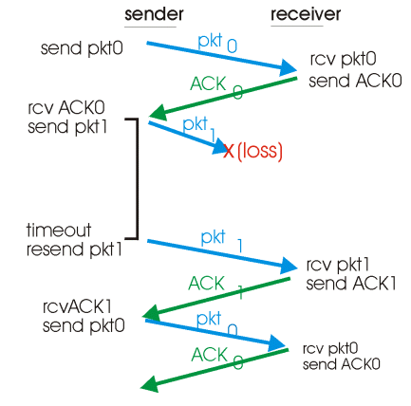
version 3.0: Lost package

Slide 65
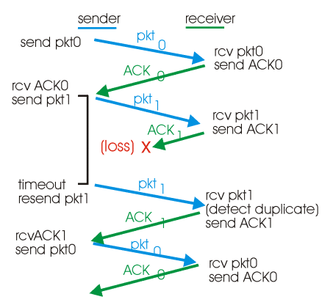
version 3.0: Lost ACK

Slide 66
version 3.0: Stop&Wait Performance
version 3.0 works so far, but performance is lusen
Example:
1 KB package is shipped from Los Angeles to New York
Transmission time of 4500 km is 15 milliseconds
Bandwidth of 1 Gb / s takes 8 microseconds to get the entire packet out on the channel
Assumes the same length of time on the ACK
Has then spent 30.016 milliseconds transferring a packet
The channel utilization will be: 0.14 per mille (1/6667)
sender
receiver
First bit of the packet sent out, t = 0
last bit sent out, t = L / R
first bit arrives
RTT
Last bit arrives, send ACK
ACK arrives, send next
package, t = RTT + L / R

Slide 67
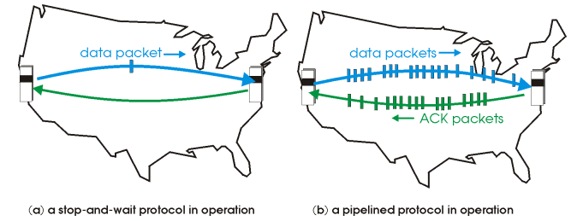
Protocols with pipelining
Use of pipeline allows many packages "in the air" at the same time, ie «better bandwidth»
Sequence numbers must then be large enough
The sender / recipient must establish packet buffers

Slide 68
Pipelining: send more before ACK received
sender
mottager
first bit sent, t = 0
last bit in the package sent,
t = L / R
first bit arrives
RTT
last bit arrives, send ACK
last bit in package 2 arrives, send ACK
last bit in package 3 arrives, send ACK
ACK arrives, send next
package, t = RTT + L / R
Line utilization increases with
a factor of 3!

Slide 69
Sliding window
Example with three bit sequence number
Packages
Packages sent
Packages that can be sent (window)
5
6
7
0
1
2
3
4
5
6
7
0
1
2
3
Sending packages shrinks the window from the left
Receiving ACK moves the right edge to the right

Slide 70
SR (Selective Repeat) Principle
Recipient gives ACK on each and every received package
Must have buffer to sort received packets
ACK also on unsolicited packages.
Sender sends only about packages without received ACK
Must have timer for each package

Slide 71
Reliability: Summary
RDT | Situasjon | Problem | Løsning
1.0 | Reliable channel | None
2.0 | Bit error on the line | Data becomes dull | Error detection (checksum) Receipt messages (ACK, NAK) Resending in case of reported error
2.1 | Bit error | Error in receipt messages Duplicate | (Stop-Wait) Sequence number of data packets (0.1)
2.2 | Bitfeil | ”Kompleksitet” | Fjerner NAK, sender heller ACK med sekvensnummer for siste korrekt mottatte pakke
3.0 | + Loss of packages | Stop-Wait + packs away in the net | Timer
To achieve performance, we use pipeling
This presupposes that we keep track of which packages are "in the air" with regard to receipts
Requires buffers for unrecognized packets that may need to be resent
TCP uses both window and selective retransmission…

Slide 72
Transmission Control Protocol
IN PRACTICE

Slide 73
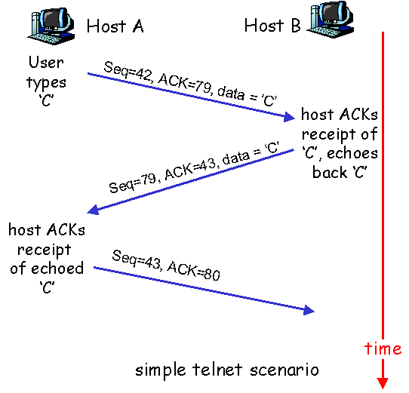
Sequence number and ACK
TCP is byte-oriented.
Sequence number
Byte flow number for the first byte in the segment
ACK-number
Sequence number of the next byte expected from the other side
Cumulative ACK
Segments out of order
Not covered by the TCP specification, but must be handled in the implementation

Slide 74
TCP ACK generation [RFC 1122, RFC 2581]
Event at Recipient
Arrival of segment in the correct
order with expected seq #.
All data already ACKet
Arrival of segment in the correct
order with expected seq #.
A previous segment has arrived,
but not ACKet
Arrival of segment out of order
with higher seq # than expected
(Gap detected)
Arrival of segments that partially
or completely fill the gap
TCP Receiver Handling
Delayed ACK. Wait up to 0.5 s on the
next segment. If it does not arrive, send ACK.
Send immediately cumulative ACK
(works as ACK for both)
Send duplicate ACK immediately,
which indicates seq # for the next
expected byte
Send immediate ACK
(assuming the segment
starts at the "bottom of the gap")

Slide 75
RTT (Round Trip Time) og timeout
How big should one choose the timeout value?
Longer than RTT
RTT varies!
Too short a timeout value results in unnecessary retransmission
Too long a timeout value gives too bad a reaction to segment loss
Measures the time from sent segment to received ACK
Does not include transmit and cumulative ACK in the measurements
Must take into account that RTT varies
Most interested in the latest measurements

Slide 76
Example RTT estimation:

Slide 77
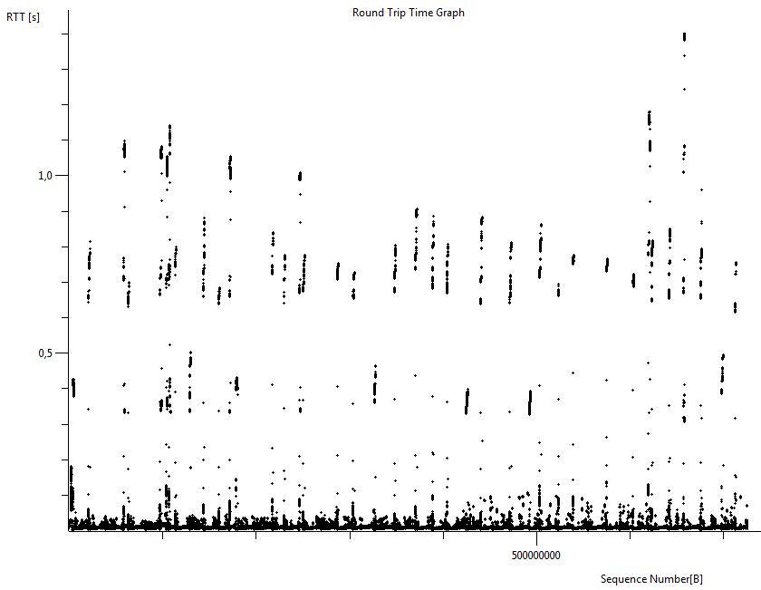
Wireshark: RTT
Uploads 1 GB to home.nith.no
RTT varies between well below 1/10 ms and 1.4 s (approx. Factor 10,000)

Slide 78
Calculation of timeout
Calculation of equalized RTT.
EstimatedRTT = (1-x)*EstimatedRTT + x*SampleRTT
Exponentially weighted, moving average
Recent measurements weigh heaviest
Typical values for x: 1/8 1/10.
Calculation of timeout
EstimatedRTT plus a safety margin
The greater the variation in EstimatedRTT, the greater the safety margin
Timeout = EstimatedRTT + 4*Deviation
Deviation = (1-x)*Deviation + x*|SampleRTT-EstimatedRTT|

Slide 79
TCP traffic cork control
End to end control (no web layer assistance)
transmitter limits transmission:
LastByteSent-LastByteAcked
≤ CongWin
Approximate:
CongWin is a dynamic function of perceived saturation in the web
How does the transmitter assess whether there is saturation?
segment loss = timeout or 3 duplicate receipts
TCP transmitter reduces the rate (CongWin) after segment loss.
three mechanisms:
AIMD
slow start
reaction to timeout
CongWin
Eff. bitrate =
byte/s
RTT

Slide 80
TCP traffic cork control (AIMD)
Method: Carefully increase the emission rate (window size), look for available bandwidth, until packet loss occurs.
Additive increase: increase CongWin by 1 MSS (Max Segment Size) each RTT until packet loss occurs
multiplicative lowering: cut CongWin in half after packet loss.
Sagtann behavior:
Tests the bandwidth until there
is a packet loss
Sharply reduces emissions
Tests again…

Slide 81
TCP AIMD
multiplicative reduction (MD):
half CongWin after segment loss (minimum one MSS)
additive increase (AI): CongWin ncreased by one MSS for each RTT in the absence of segment loss (congestion avoidance phase)
Long-lasting TCP connection

Slide 82
TCP Slow-start
When the connection is established, CongWin = 1 MSS
Example: MSS = 500 octets and RTT = 200 ms
initiell rate = 20 kb/s
available data rate may be >> MSS/RTT
desirable to increase the rate immediately up to a reasonable level
When the connection is established, increase the rate exponentially until the first segment loss
It is now common to use Windowscaling: Typically you start with 2 MSS in CongWin

Slide 83
TCP Slow-start
At the start of the connection, the rate increases exponentially until you experience segment loss:
CongWin doubles each RTT
done by increasing CongWin for each ACK received
Summarized: initial rate is low but increasing exponentially
Host A
Host B
ett segment
RTT
to segmenter
fire segmenter
tid

Slide 84
Reaction to segment loss
After three duplicate receipts:
CongWin is half
the window then grows linearly.
But after the timeout:
CongWin is set to one MSS
the window then grows exponentially up to half the value before timeout, and then grows linearly
Philosophy:
3 duplicate ACKs indicate that the network can actually deliver a number of segments as these come through
Timeout before 3 duplicate ACKs is more alarming, then it seems that very little comes through

Slide 85
Response to segment loss (continued)
Q: Når skal eksponentiell økning endres til lineær?
A: When CongWin becomes half of its value before timeout.
receipt of three duplicate receipts
Implementation:
Variable threshold
In the event of a segment loss, the threshold is set at half of what CongWin was before the segment loss

Slide 86
Summary: TCP saturation control
When CongWin is lower than Threshold, the transmitter is in the slow-start phase; window increases exponentially.
When CongWin is larger than Threshold, the transmitter is in the congestion-avoidance phase; window increases linearly.
When transmitter receives a triple duplicate ACK, Threshold is set to CongWin / 2 and CongWin is set to Threshold.
When the sender is timed out, Threshold is set to CongWin / 2 and CongWin to one MSS.

Slide 87
TCP sends saturation control
Event | State | TCP sender action | Comment
ACK received for un-recognized data | Slow Start (SS) | CongWin = CongWin + MSS, If (CongWin> Threshold) change mode to “Congestion Avoidance” | Resulting in a doubling of CongWin each RTT
ACK received for un-recognized data | Congestion Avoidance (CA) | CongWin = CongWin+MSS * (MSS/CongWin) | Additive increase, results in an increase of CongWin by 1 MSS each RTT
Lose up on receipt of three duplicate ACKs | SS or CA | Threshold = CongWin / 2, CongWin = Threshold, Set state to “Congestion Avoidance” | Fast recovery, multiplicative decrease. CongWin will never be reduced to less than 1 MSS
Timeout | SS or CA | Threshold = CongWin / 2, CongWin = 1 MSS, Switch mode to "slow start" | Goes in slow start
Duplicate ACK | SS or CA | Increase the count for the number of duplicate ACKs | No change in CongWin or Threshold

Slide 88
The state machine…
.
duplicate ACK
new ACK
dupACKcount++
new ACK
cwnd = cwnd + MSS (MSS/cwnd)
dupACKcount = 0
transmit new segment(s),as allowed
cwnd = cwnd+MSS
dupACKcount = 0
transmit new segment(s),as allowed
Λ
cwnd = 1 MSS
ssthresh = 64 KB
dupACKcount = 0
cwnd > ssthresh
slow
start
Λ
congestion
avoidance
timeout
ssthresh = cwnd/2
cwnd = 1 MSS
dupACKcount = 0
retransmit missing segment
duplicate ACK
timeout
dupACKcount++
ssthresh = cwnd/2
cwnd = 1 MSS
dupACKcount = 0
retransmit missing segment
timeout
ssthresh = cwnd/2
cwnd = 1
dupACKcount = 0
retransmit missing segment
New ACK
dupACKcount == 3
cwnd = ssthresh
dupACKcount = 0
dupACKcount == 3
ssthresh= cwnd/2
cwnd = ssthresh + 3
retransmit missing segment
ssthresh= cwnd/2
cwnd = ssthresh + 3
retransmit missing segment
fast
recovery
duplicate ACK
cwnd = cwnd + MSS
transmit new segment(s), as allowed

Slide 89
TCP effective bit rate (throughput)
What is the best performance you can get with TCP
M.a.o What will be the effective bit rate for TCP as a function of window size and RTT?
Disregards the slow start phase
Let W be the window size when segment loss occurs
When the window is W, the effective bit rate will be W / RTT
Immediately after segment loss, the window will be reduced to W / 2 and the effective bit rate to ½ · W / RTT.
Average effective bit rate (approximate):
¾·W/RTT
It is thus the saturation & flow control window size that determines what "performance" you get over TCP !!!

Slide 90
Effective bit rate (example)
Uses a server in Tromsø (www.uit.no)
RTT = approx. 22 ms (measured with pathping)
In classic TCP ("vanilla"), the maximum window size is 64 KiB
Max (theoretical) flow then becomes (65535 ∙ 8 𝑏) / (0.022 𝑠) = 23.8 𝑀𝑏𝑝𝑠, but that is only if there is never a segment loss…
Automatic Windows scaling will increase this in many modern systems, but this assumes that the server also supports scaling
RFC 1323 specifies how to switch to Jumbo windows and achieve even greater maximum throughput

Slide 91
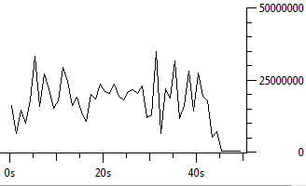
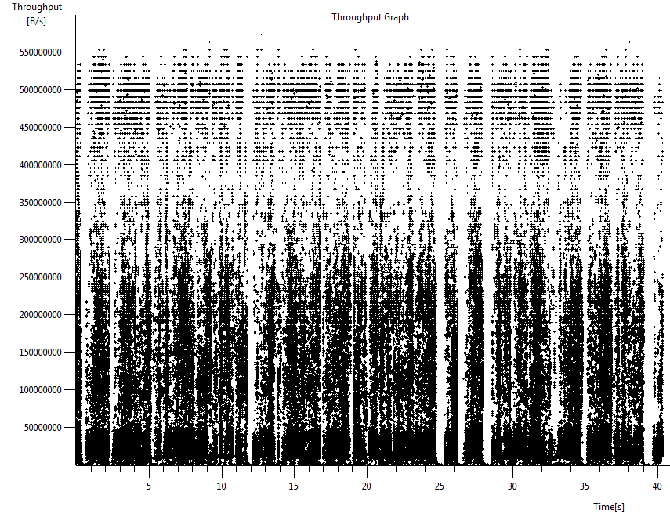
Wireshark: Flow
Uploads 1 GB to home.nith.no
B/s

Slide 92
Future of TCP 1: TCP over "long, thick pipes"
Example: 1500 Byte segment, 100ms RTT, We would like 10 Gbps throughput
This then requires a minimum window size of W = 83,333 segments on the line
Flow rate in relation to loss rate (L):
➜ L = 2·10⁻¹⁰ = only about two out of ten billion packages can be lost.
TCP is also problematic in wireless networks, where packet loss is much more common than in wired.
New versions of TCP are needed!

Slide 93
TCP's future 2: interactivity over «thin tubes»
Can use UDP, but must then add custom reliability mechanisms a la TCP into the application itself
QUIC (Google, Chrome)
Complicates
The focus in R&D so far has been on "thick tubes" and high latency, not on interactivity
Petland (2009) shows that in the game Anarchy Online, old (New Reno) works better than some of the newer TCP implementations!
In addition, TCP is needed, which detects and takes into account real-time and thin tubes.

Slide 94
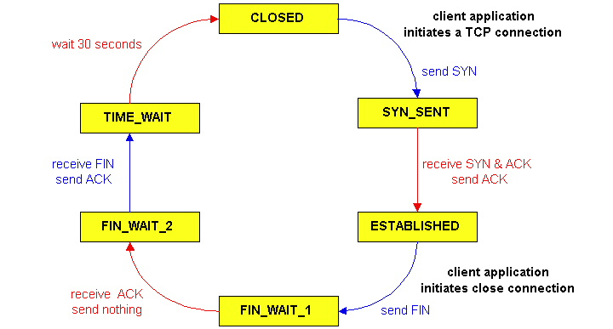
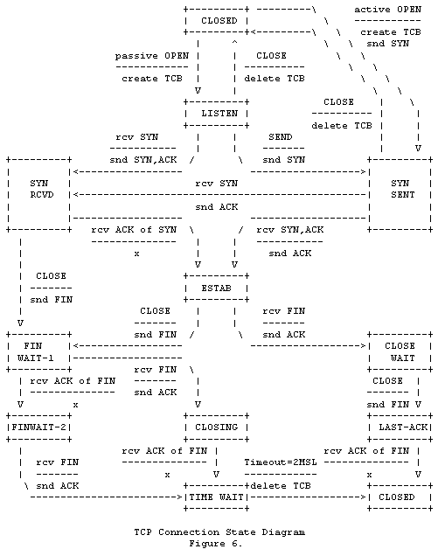
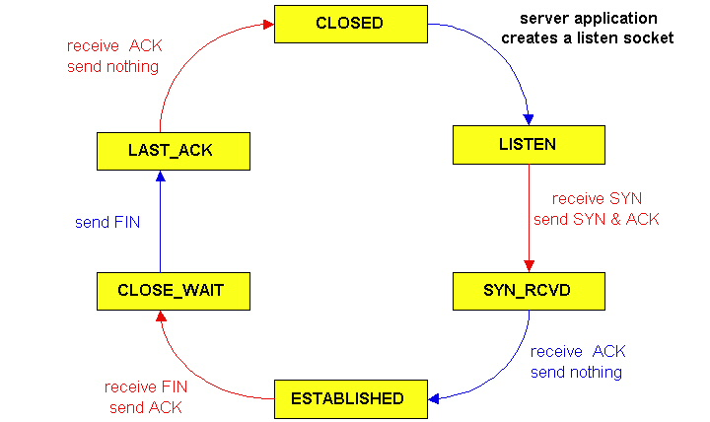
TCP: Life Cycle
TCP-
Client
TCP-
Klient
TCP-
Server

